Slide 1

SIT1302 Internet Programming
UNIT 2
JavaScript
Ms.J.S.Vimali
SIT1302 School of Computing

Slide 2
JavaScript Output
JavaScript Display Possibilities
JavaScript can "display" data in different ways:
Writing into an HTML element, using innerHTML.
Writing into the HTML output using document.write().
Writing into an alert box, using window.alert().
Writing into the browser console, using console.log().
Using innerHTML
To access an HTML element, JavaScript can use the document.getElementById(id) method.
The id attribute defines the HTML element.
The innerHTML property defines the HTML content
SIT1302 School of Computing

Slide 3
<!DOCTYPE html>
<html>
<body>
<h2>My First Web Page</h2>
<p>My First Paragraph.</p>
<p id="demo"></p>
<script>
document.getElementById("demo").innerHTML = 5 + 6;
</script>
</body>
</html>
SIT1302 School of Computing

Slide 4
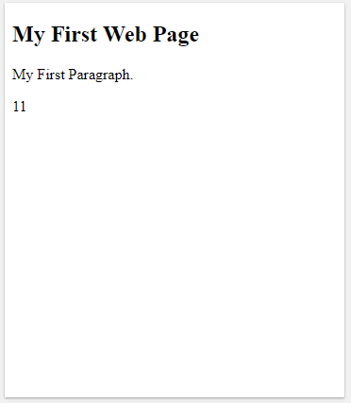
OUTPUT
SIT1302 School of Computing

Slide 5
Changing the innerHTML property of an HTML element is a common way to display data in HTML.
Using document.write()
For testing purposes, it is convenient to use document.write()
<!DOCTYPE html>
<html>
<body>
<h2>My First Web Page</h2>
<p>My first paragraph.</p>
<p>Never call document.write after the document has finished loading.
It will overwrite the whole document.</p>
<script>
document.write(5 + 6);
</script>
</body>
</html>
SIT1302 School of Computing

Slide 6
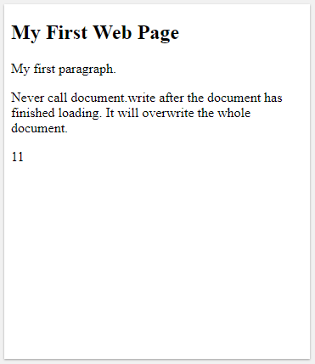
OUTPUT
SIT1302 School of Computing

Slide 7
Using document.write() after an HTML document is loaded, will delete all existing HTML:
<!DOCTYPE html>
<html>
<body>
<h2>My First Web Page</h2>
<p>My first paragraph.</p>
<button type="button" onclick="document.write(5 + 6)">Try it</button>
</body>
</html>
SIT1302 School of Computing

Slide 8
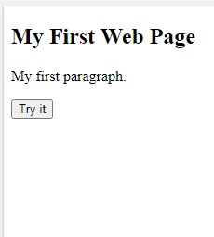
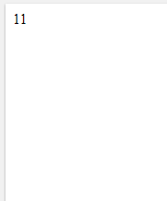
OUTPUT
The document.write() method should only be used for testing.
SIT1302 School of Computing
OUTPUT

Slide 9
Using window.alert()
You can use an alert box to display data
<!DOCTYPE html>
<html>
<body>
<h2>My First Web Page</h2>
<p>My first paragraph.</p>
<script>
window.alert(5 + 6);
</script>
</body>
</html> >
SIT1302 School of Computing

Slide 10
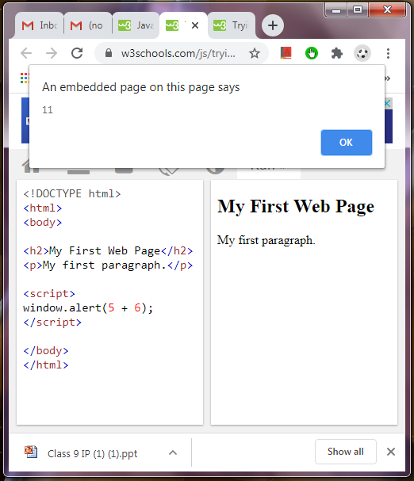
OUTPUT
SIT1302 School of Computing

Slide 11
Using console.log()
For debugging purposes, you can call the console.log() method in the browser to display data.
You will learn more about debugging in a later chapter.
<!DOCTYPE html>
<html>
<body>
<h2>Activate Debugging</h2>
<p>F12 on your keybord will activate debugging.</p>
<p>Then select "Console" in the debugger menu.</p>
<p>Then click Run again.</p>
<script>
console.log(5 + 6);
</script>
</body>
</html>
<script src="myScript.js"></script>
SIT1302 School of Computing

Slide 12
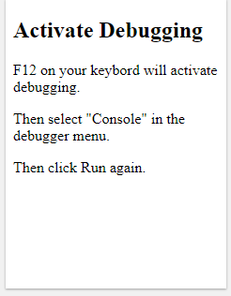
OUTPUT
SIT1302 School of Computing

Slide 13
JavaScript Print
JavaScript does not have any print object or print methods.
You cannot access output devices from JavaScript.
The only exception is that you can call the window.print() method in the browser to print the content of the current window.
Example
<!DOCTYPE html>
<html>
<body>
<button onclick="window.print()">Print this page</button>
</body>
</html>
SIT1302 School of Computing

Slide 14
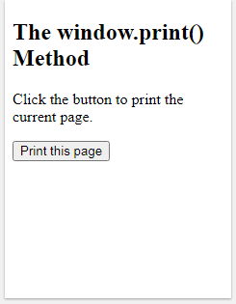
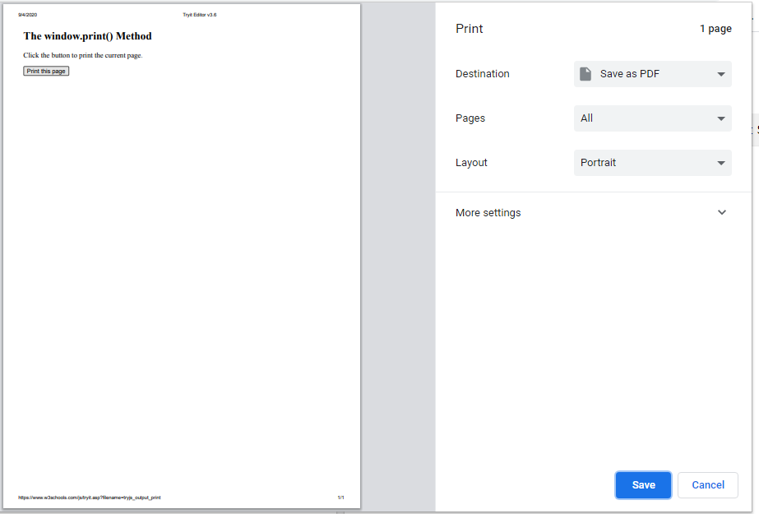
OUTPUT
SIT1302 School of Computing

Slide 15
JavaScript Statements
SIT1302 School of Computing

Slide 16
Example
var x, y, z; // Statement 1
x = 5; // Statement 2
y = 6; // Statement 3
z = x + y; // Statement 4
JavaScript Programs
A computer program is a list of "instructions" to be "executed" by a computer.
In a programming language, these programming instructions are called statements.
A JavaScript program is a list of programming statements.
In HTML, JavaScript programs are executed by the web browser.
JavaScript Statements
JavaScript statements are composed of:
Values, Operators, Expressions, Keywords, and Comments.
This statement tells the browser to write "Hello Dolly." inside an HTML element with id="demo":
SIT1302 School of Computing

Slide 17
JavaScript Keywords
JavaScript statements often start with a keyword to identify the JavaScript action to be performed.
Visit our Reserved Words reference to view a full list of JavaScript keywords.
Here is a list of some of the keywords you will learn about in this tutorial:
JavaScript keywords are reserved words. Reserved words cannot be used as names for variables.
Keyword | Description
break | Terminates a switch or a loop
continue | Jumps out of a loop and starts at the top
debugger | Stops the execution of JavaScript, and calls (if available) the debugging function
do ... while | Executes a block of statements, and repeats the block, while a condition is true
for | Marks a block of statements to be executed, as long as a condition is true
function | Declares a function
if ... else | Marks a block of statements to be executed, depending on a condition
return | Exits a function
switch | Marks a block of statements to be executed, depending on different cases
try ... catch | Implements error handling to a block of statements
var | Declares a variable
SIT1302 School of Computing

Slide 18
JavaScript Syntax
JavaScript syntax is the set of rules, how JavaScript programs are constructed:
var x, y, z; // Declare Variables
x = 5; y = 6; // Assign Values
z = x + y; // Compute Values
JavaScript Values
The JavaScript syntax defines two types of values:
Fixed values
Variable values
Fixed values are called Literals.
Variable values are called Variables.
SIT1302 School of Computing

Slide 19
JavaScript Literals
The two most important syntax rules for fixed values are:
1. Numbers are written with or without decimals:
10.50
1001
2. Strings are text, written within double or single quotes:
"John Doe"
'John Doe‘
JavaScript Variables
In a programming language, variables are used to store data values.
JavaScript uses the var keyword to declare variables.
An equal sign is used to assign values to variables.
In this example, x is defined as a variable. Then, x is assigned (given) the value 6:
var x;
x = 6;
SIT1302 School of Computing

Slide 20
SIT1302 School of Computing

